Slide 1
Presentation On
Online Shopping

Slide 2
Group members
Name ID
Hasibul Malek Badhon 153-15-6632
Marfi Akter Laboni 153-15-6592
Rashed Bin Razzaque 151-15-4892
Jahidul Islam Ontu 153-15-6586
Ashrifa Yesmin Pinky 153-15-6609

Slide 3
Table of content
Introduction
Objective
Development tools
Implementation
User Interface and Functionality
Advantages & Disadvantages
Conclusion & future work

Slide 4
Introduction
This project make in this way that many people can shopping in a same time.
No way to swap any persons product to another person.
Easy shipping system to send product in your given address
Don’t need to learn anything to use this program.
Anyone can shopping from anywhere.
Don’t need to Argue about price.
This is the future of Shopping System.

Slide 5
Objectives:
In this technology world we always want every thing in a easy way. So waste too much time and face difficulty for Shopping.
Suppose You want to buy something but don’t have time or don’t want to go shop for shopping. That is our main goal to fulfill your expectation and send your desire product in your given address without any problem.
This program is mainly made for Shopping and Blogging purpose.

Slide 6
Development tools and software
Tool : Sublime Text 3,WordPress, XAMPP, Mozilla Fire-Fox.
Language: HTML, CSS, JavaScript, PHP, MySQL.

Slide 7
Implementation
Full system create in a Easy way that anyone can use it without knowing programming or idea of programming.
Blogging, Contact Us and About Us included.
Choose product to buy in future Cart included.
Multiple product buy in a same time and calculate total price and other cost included.
Product Details, Pictures, Quantity and Additional Information Included.
Easy payment system included.
View or Give review of product included.
Free Shipping into the whole country.
Products are Sorted into different variation.

Slide 8
What we used:
For making this project of Front-End part we use HTML, CSS, JavaScript and PHP. Which part create for user to view and buy from our Online Shop.
We use PHP framework WordPress form manage the back-end section. Administration will be Control every Single thing what's going on from the Back-End part.
With the help of this Powerful Back-End Administration can Update the Online Shop and Do many things for the users.

Slide 9
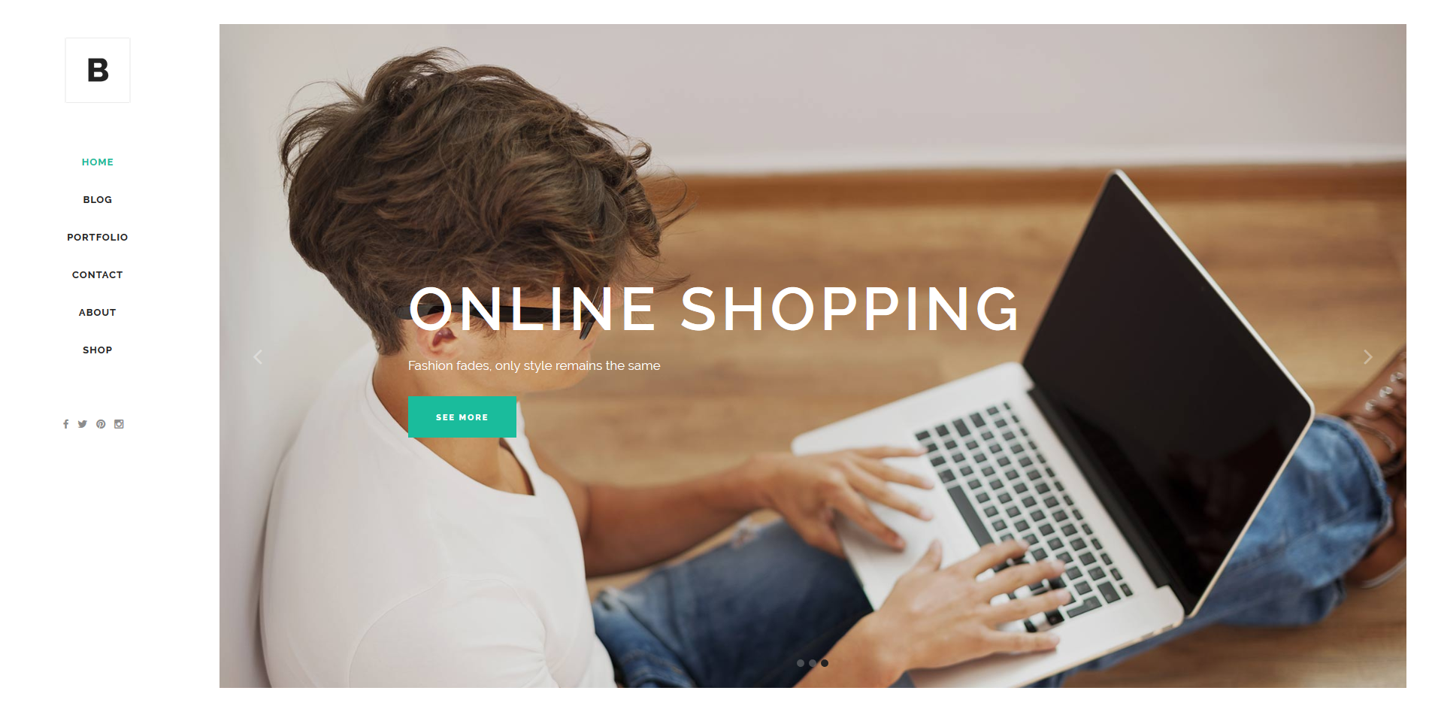
User Interface and Functionality
Home Page

Slide 10
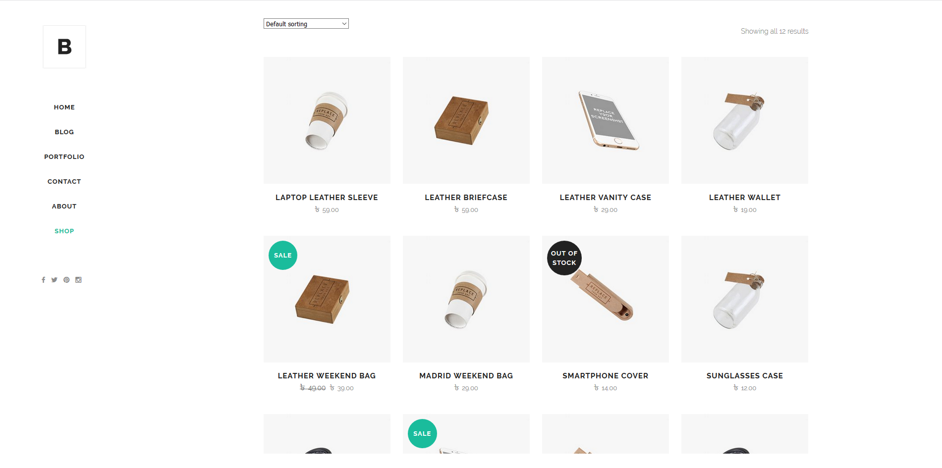
Shopping Page

Slide 11
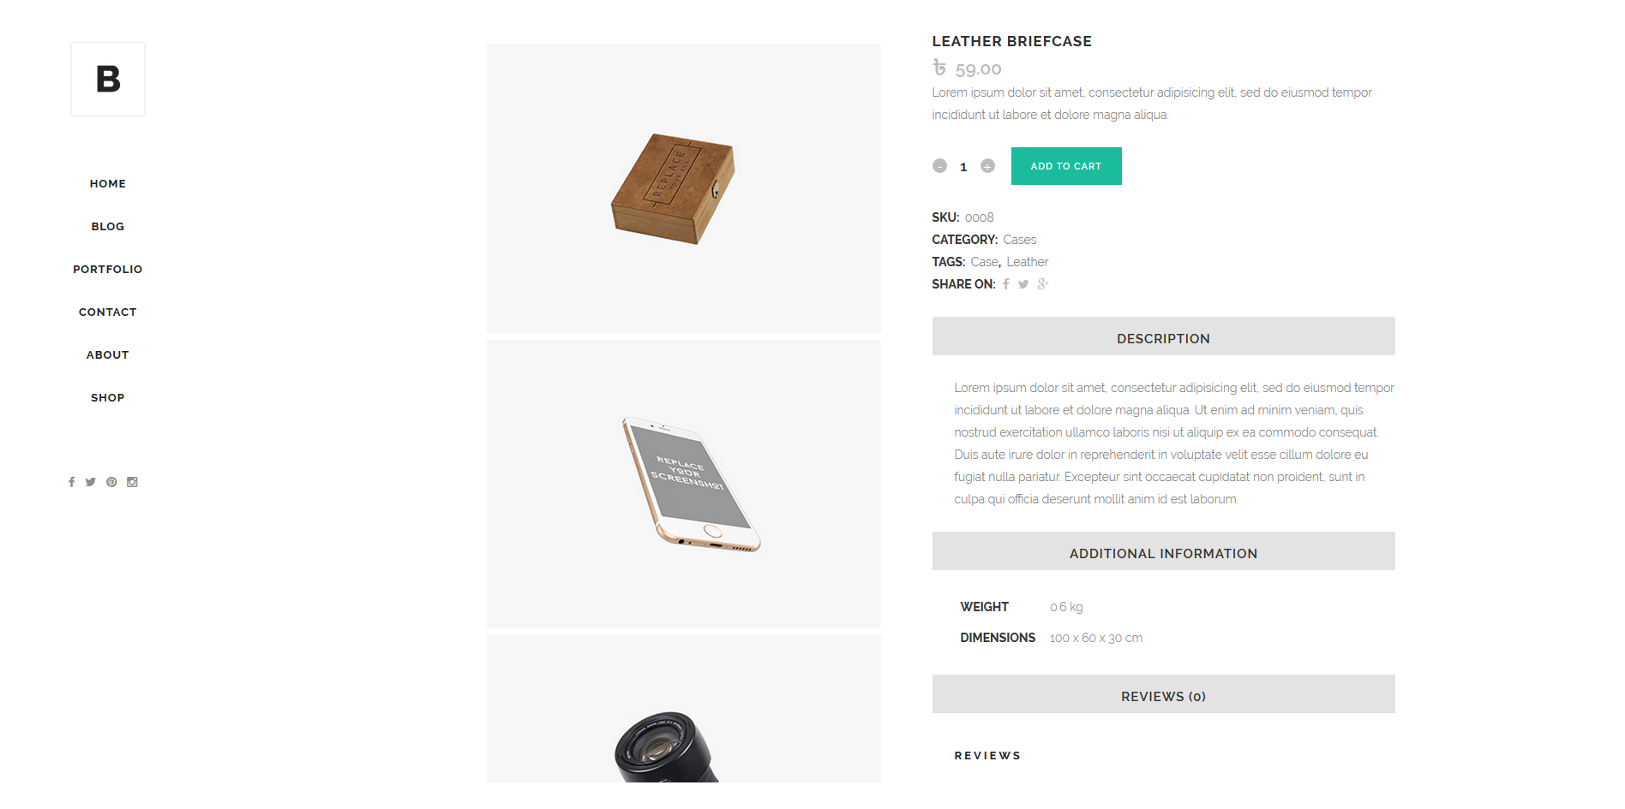
Inside Single Product Page

Slide 12
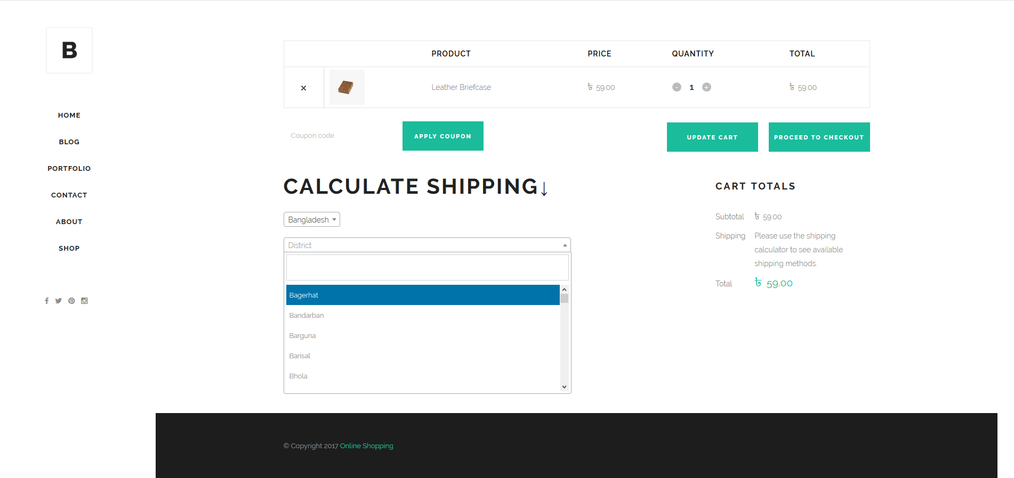
Cart Page

Slide 13
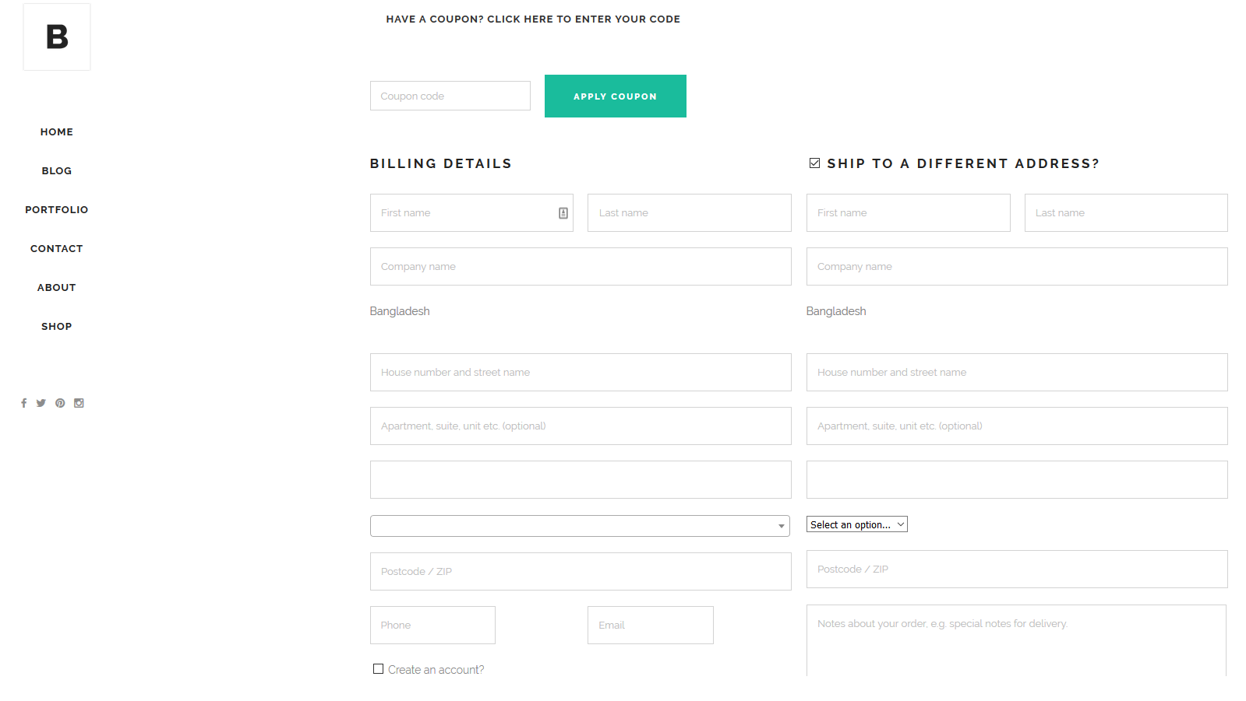
Checkout Page

Slide 14
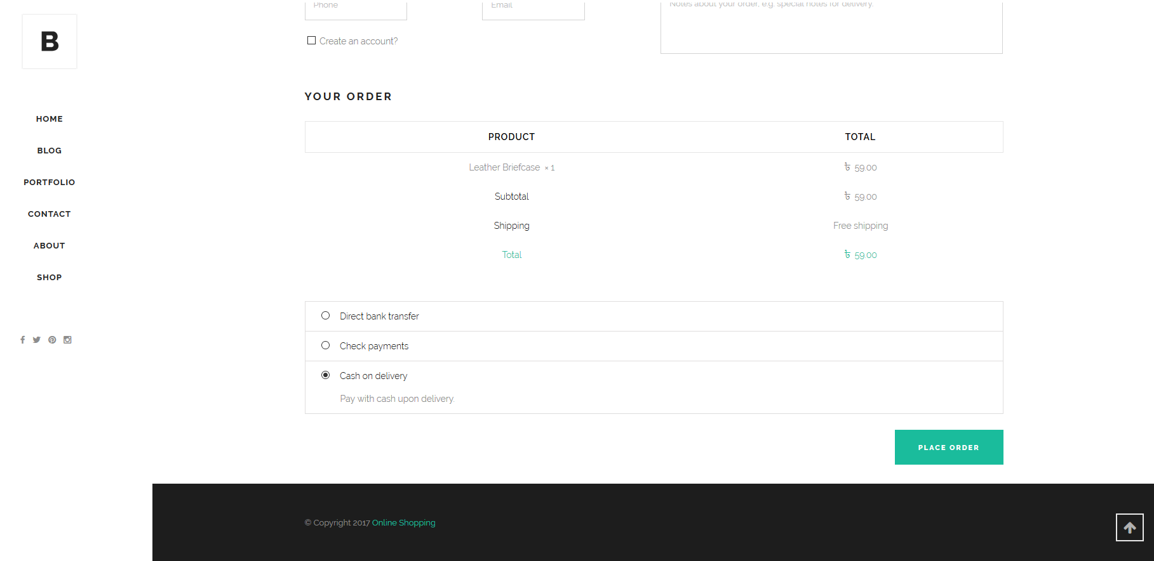
Order Details And Payment Options

Slide 15
Advantages and disadvantages
Easily can buy something from home or anywhere.
People can choose product from a lot of collection without walking through shop to shop.
A Great Powerful Application.
DISADVANTAGES:
Lack of Customers.
Huge lack of Customers trust.
Lack of Marketing and Branding.

Slide 16
Future work and conclusion
In future we will make our program to accept local and international many payment system.
We will make our project such a way that anybody can buy products from any corner of the world.
We will include more product for more customers satisfactions.
In future we will make the Free Shipping system over the whole World Wide.

Slide 17
Thank You ☺

